Slide 1
Chapter 8 Memory and Programmable Logic Device
8.1 Programmable Logic Device
8.2 Read-Only Memory
8.3 Random-Access Memory

Slide 2
8.1 Programmable Logic Device (PLD)
PLD AND array OR array Output circuit
PROM Fixed Programmable Fixed
PLA Programmable Programmable Fixed
PAL Programmable Fixed Fixed
GAL Programmable Fixed Configurable

Slide 3
8.2 Read-Only Memory (ROM)
ROM with capacity 2^{n}×m bit
A₀
Decoder
A_{n-1}
Word lines
w₀
W₂^{n} -1
F₀
Memory
Bit lines
F_{m-1}

Slide 4
0
A₁
1
A₀
2-4 Decoder
V_{CC}
W₀
W₁
0
1
W₂
0
W₃
0
V₀
F₀
1
V₁
F₁
0
V₂
F₂
1
V₃
F₃
1

Slide 5
Logic functions
F₀=W₀+W₁
F₁=W₀
F₂=W₀+W₁+W₂+W₃
F₃=W₁+W₂+W₃

Slide 7
AND array
A₁
A₁
A₀
A₀
W₀
W₁
W₂
W₃
F₀=W₀+W₁
×
×
F₀
×
F₁
OR
array
F₁=W₀
×
×
×
×
F₂
F₂=W₀+W₁+W₂+W₃
×
×
×
F₃
F₃=W₁+W₂+W₃

Slide 8
Implement the following logic functions by the “AND-OR” array of ROM.

Slide 10
A
A
B
B
C
C
×
×
×
F₁
×
×
×
F₂
×
×
×
×
F₃

Slide 11
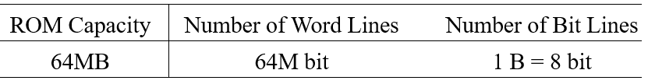
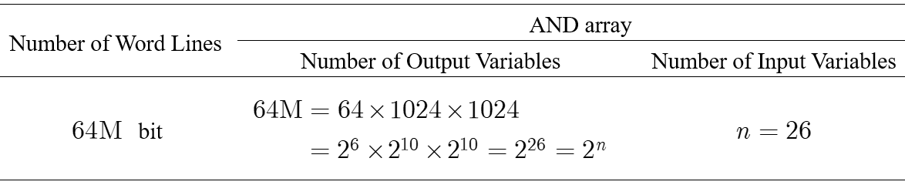
Suppose that the capacity of ROM is “64MB”. Calculate the number of input variables of ROM.

Slide 12
8.3 Random-Access Memory
(1) Static Random-Access Memory (SRAM)
(2) Dynamic Random-Access Memory (DRAM)

Slide 13
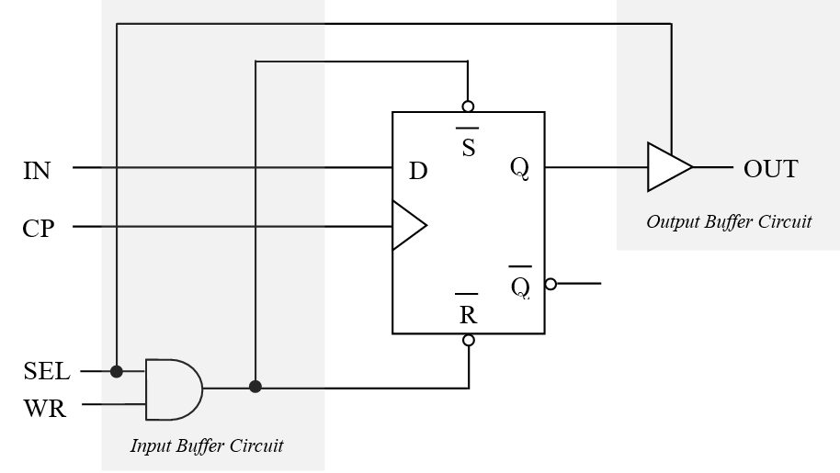
SRAM composed of D flip-flop and buffer circuits

Slide 14
DRAM composed of one NMOS transistor and one capacitor
Bit line
Word line
Word line high state →
“gate” high state→
NMOS transistor “ON” → DRAM selected
Bit line high state → capacitor charging → “1” stored on DRAM
Bit line low state → capacitor discharging → “0” stored on DRAM

